Slide 1
1.There is one facet for each value.
2. The facets are empty when there is no data for the according combination e.g. the 7 cylinder are missed totally.
3. The notation ~ dot plots the attribute values without a column attribute, thus showing multiple rows’ plots for each plot.
4. Faceting makes it easier to examine the individual classes. like in colouring it is easier to see how the classes are clustered overall.With larger dasets it’s more likely that you want to see the overall clustering instead of the individual points.
5. Facet grids have these things.
6. When putting the more levels on the row axis , then the y axis would shrink so that it is harder to see which actual values are at the points as shown by plots.

Slide 2
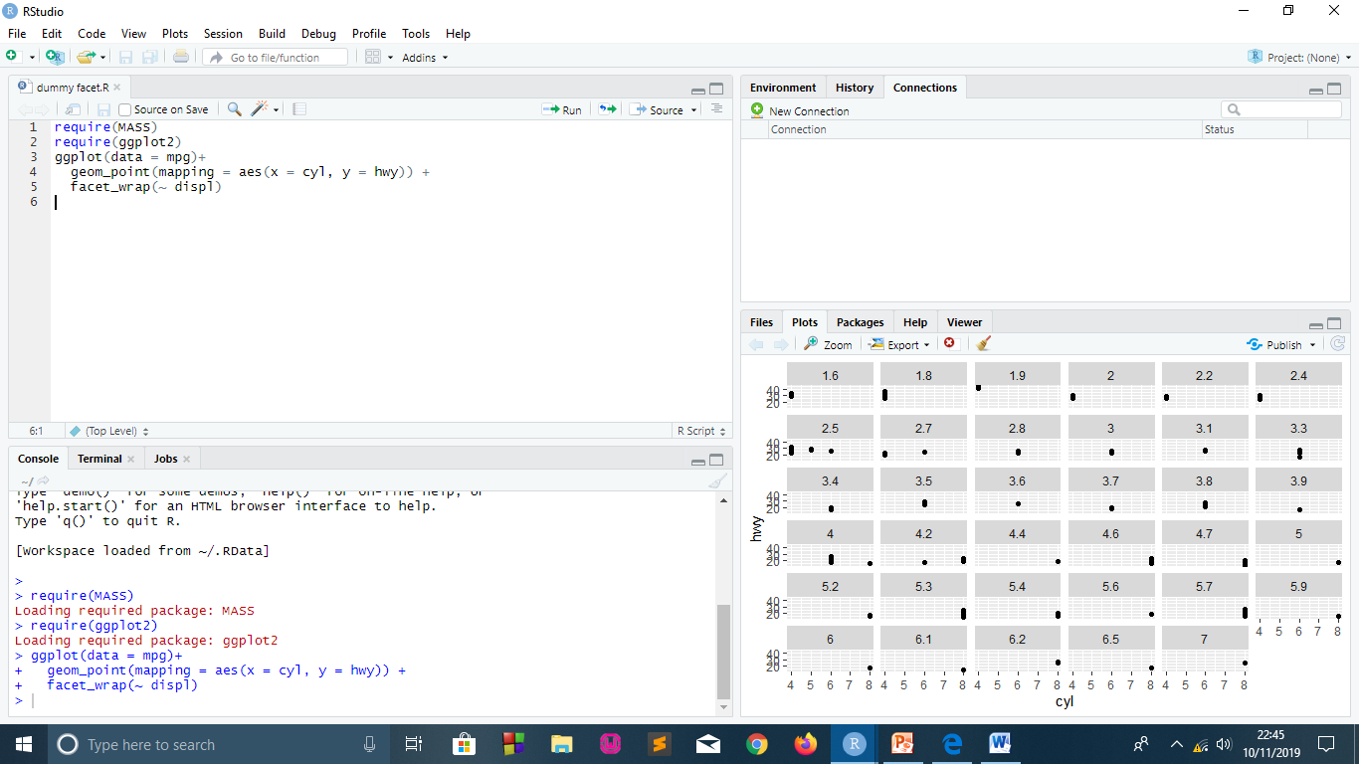

Slide 3
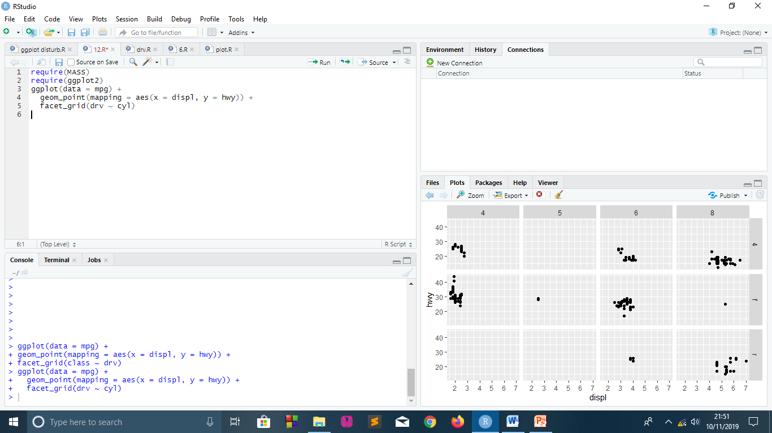

Slide 4
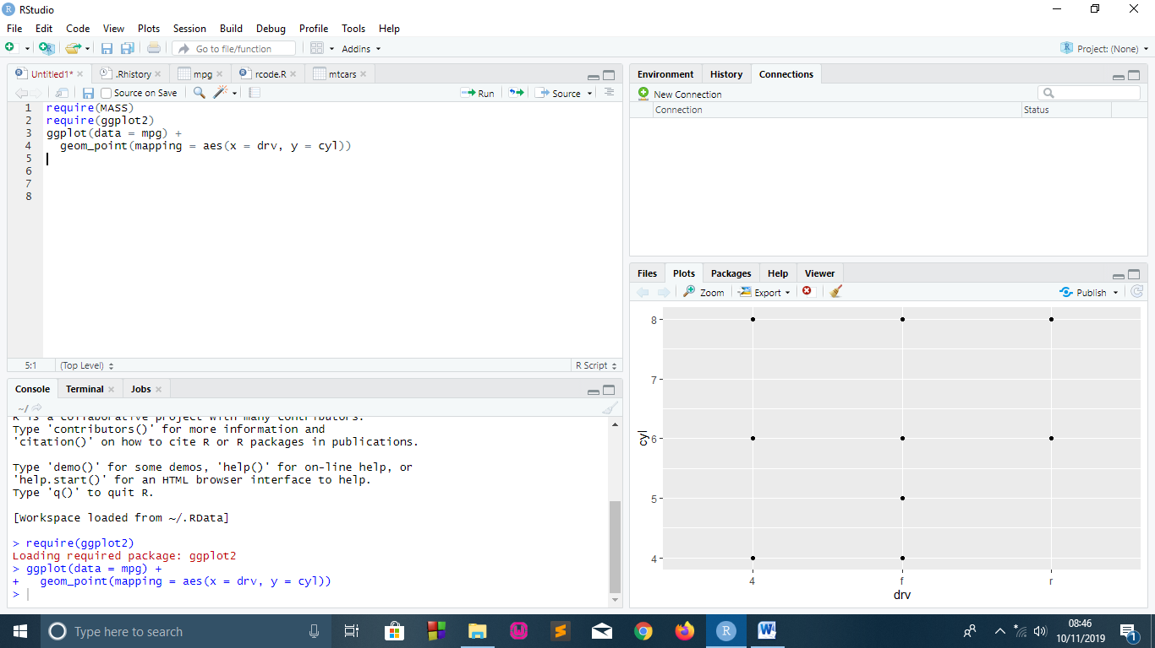

Slide 5
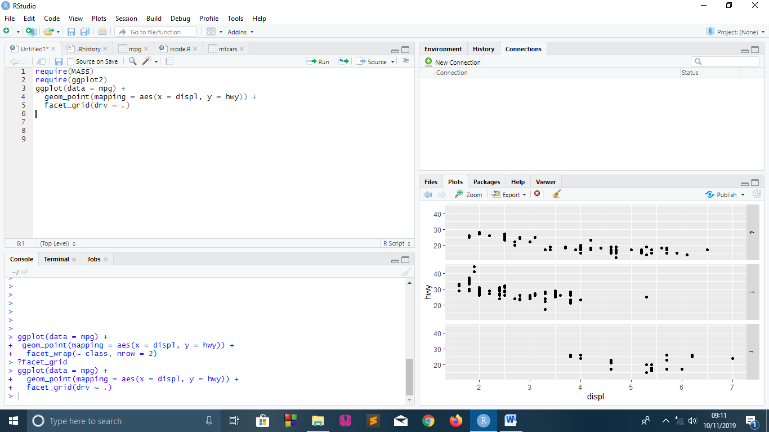

Slide 6
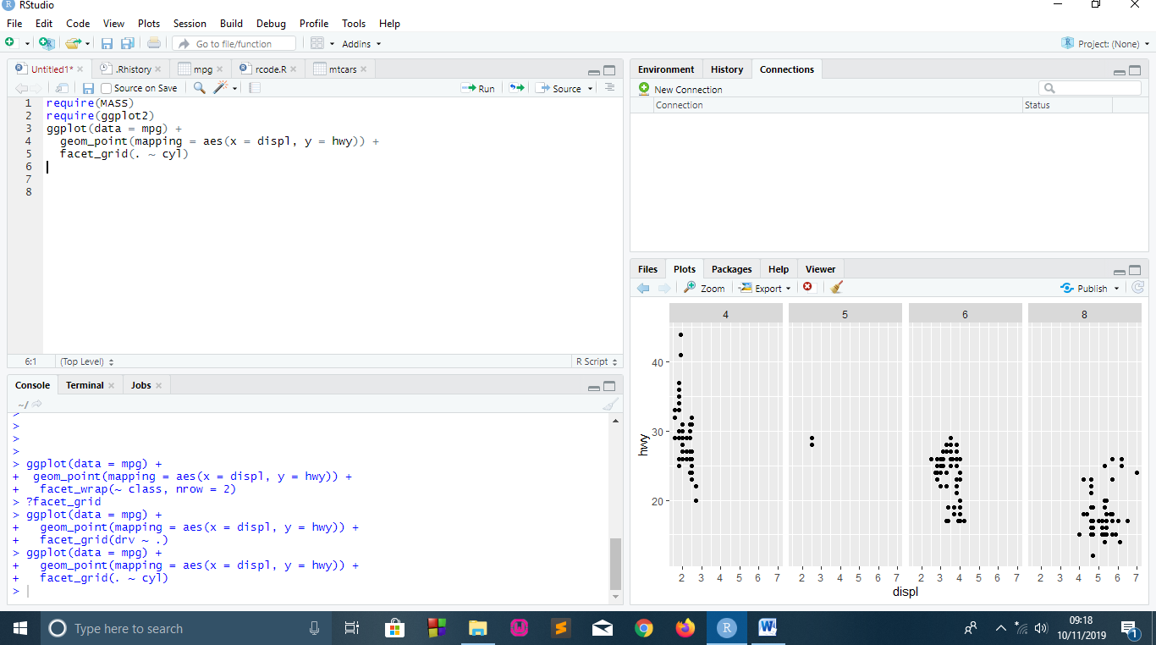

Slide 7
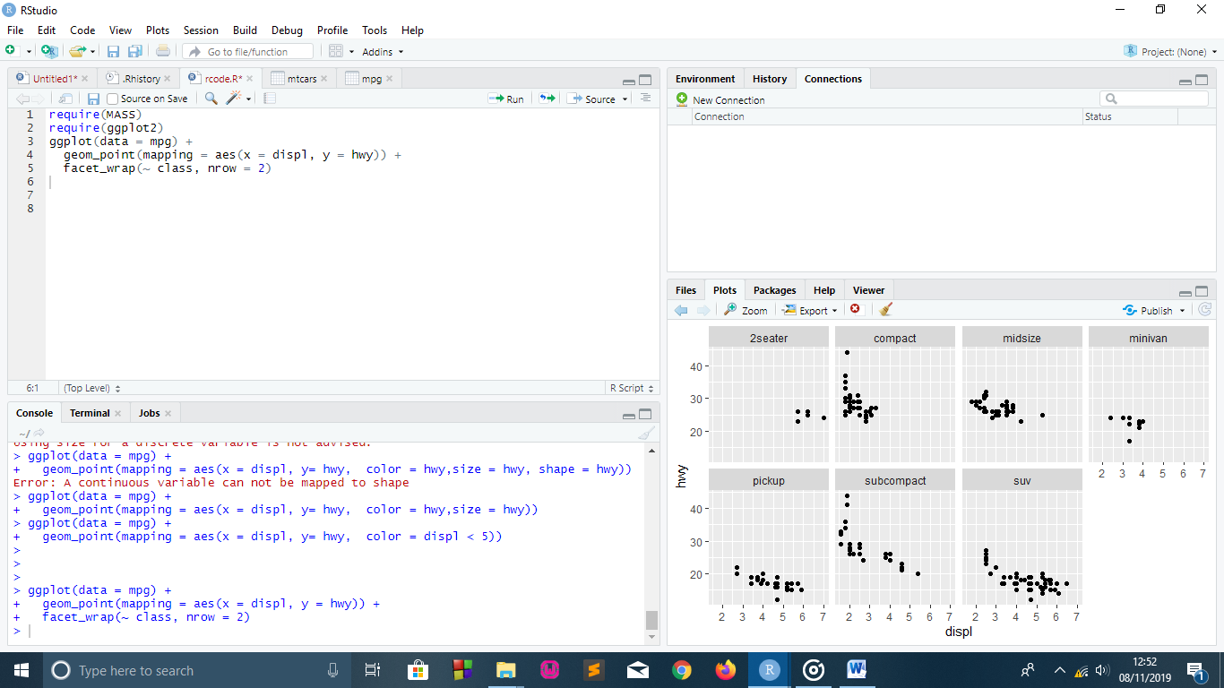

Slide 8
